Slide 1
2025
Harnessing Data for Pharma Excellence
Sibani Tiwari
23f3003311@ds.study.iitm.ac.in
Page
01

Slide 2


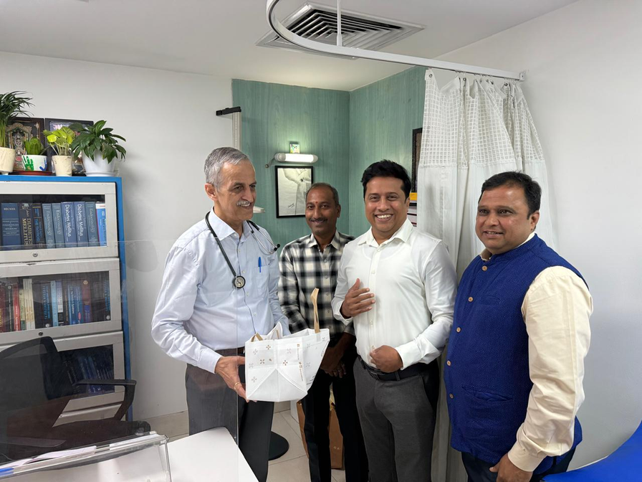
2025
Company
Background
Medicure Lifesciences India Pvt. Ltd., established in 2009 and headquartered in Hyderabad, is a fast-growing pharmaceutical company with a ₹30+ crore annual turnover
The company operates across southern India, Maharashtra, and Goa, offering over 120 trusted brands in the cardio, metabolic, and neurology segments, with plans for further expansion
Founded and led by Mr. Srinivas Rao K, Medicure is built on strong values of commitment, quality, and reliability — delivering affordable, high-quality medicines to ease the burden on patients and improve lives
Page
02

Slide 3
2025
Challenges
High Employee Attrition
Pricing Medicines Competitively
Rapid Release of New Drug Molecules
Employee retention, especially among more skilled workers is an issue as others are getting to pay them much better benefits than the company. This reduces operational efficiency and increases hiring costs.
The company’s pricing strategies are suboptimal, leading to either low demand or lost market share as competitors offer better pricing.
Due to frequent new drug launches by competitors, R&D and market adaptation are under pressure for not responding quickly enough.
Page
03

Slide 4
2025
Data
Employee Data
Product Data
Name
Headquarters
Date of Joining
Date of Birth
Designation
CTC
Gross CTC
Provident Fund
Deductions
TDS
Net Payable
Bank Details
PAN
UAN
Medicine name
Composition
MRP
PTR
PTS
Overview
To tackle these challenges following data was collected from the period 15 October, 2024 to 15 November, 2024
Page
04

Slide 5
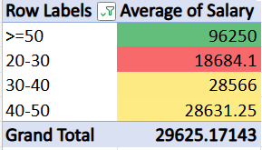
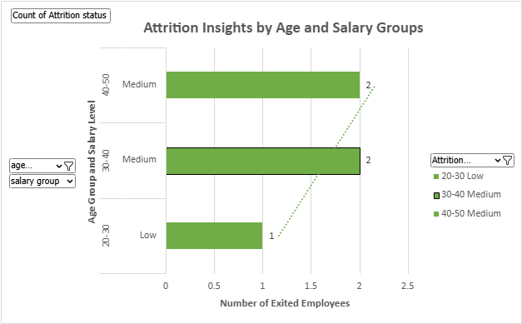
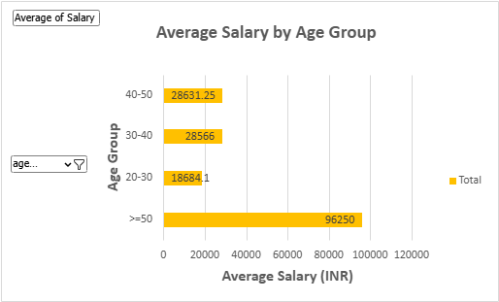
Employee
Retention Analysis
2025
Page
05

Slide 6
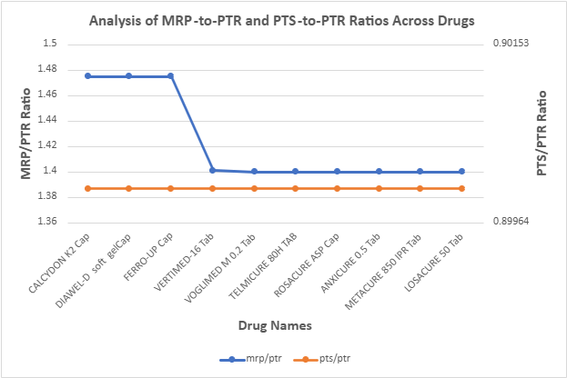
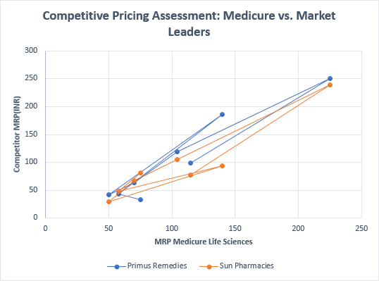
Dynamic Pricing Strategy Analysis
2025
Page
06

Slide 7
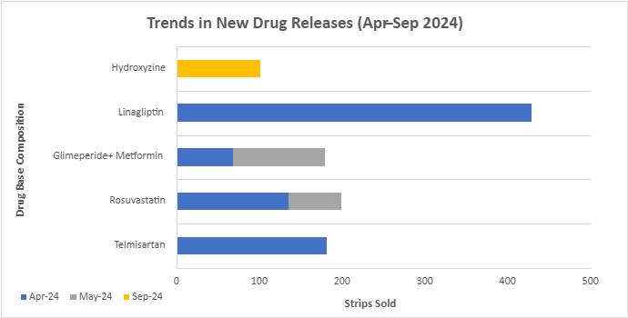
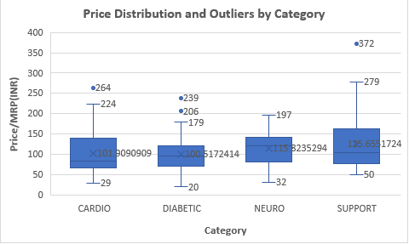
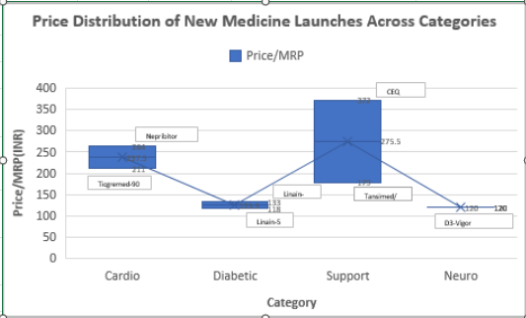
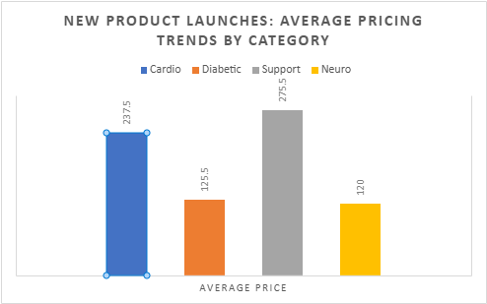
Competitor Analysis and Product Launch Monitoring
2025
Page
07

Slide 8
Results and Recommendations
2025
Mid-career employees (ages 30–50) are leaving at the highest rates, especially those in the medium salary bracket
A notable salary gap (~₹77,000) exists between junior and senior roles, while pay growth in mid-level positions appears to have stagnated
Product pricing lacks consistency—there’s a wide variation in the MRP to PTR (price to retailer) ratios across the portfolio.
Medicure’s pricing strategy often doesn’t align well with major competitors like Primus and Sun Pharma.
Newly launched products in the diabetic and cardiac segments are showing strong market traction.
Neuro category products are priced lower but maintain consistent pricing across different regions.
The Support category shows the most price fluctuation, while allergy and niche products are seeing limited sales.
Page
08

Slide 9
Results and Recommendations
2025
Introduce focused retention programs for employees aged 30–50, especially in roles with high turnover.
Create clear and fair salary structures to bridge pay gaps and support growth for mid-level employees.
Align product pricing with competitor trends and market demand to ensure consistency and competitiveness.
Invest more in R&D for fast-growing therapeutic areas like diabetes and cardiology.
Cut back on manufacturing low-performing or niche products to streamline operations.
Strengthen marketing for high-performing new products, guided by insights from regional sales data.
Boost retail presence by engaging more actively with pharmacies and enhancing in-store visibility.
Page
09

Slide 10
BDM Project Link :
https://drive.google.com/drive/folders/1KISdxqEvQdxH-7uxr6V_uw_eD7BHEkma?usp=sharing
Page
10

